Slide 1
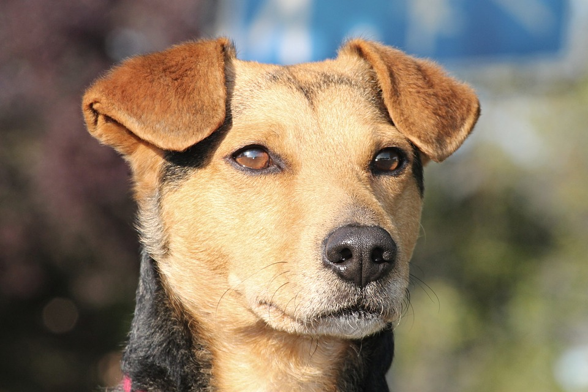
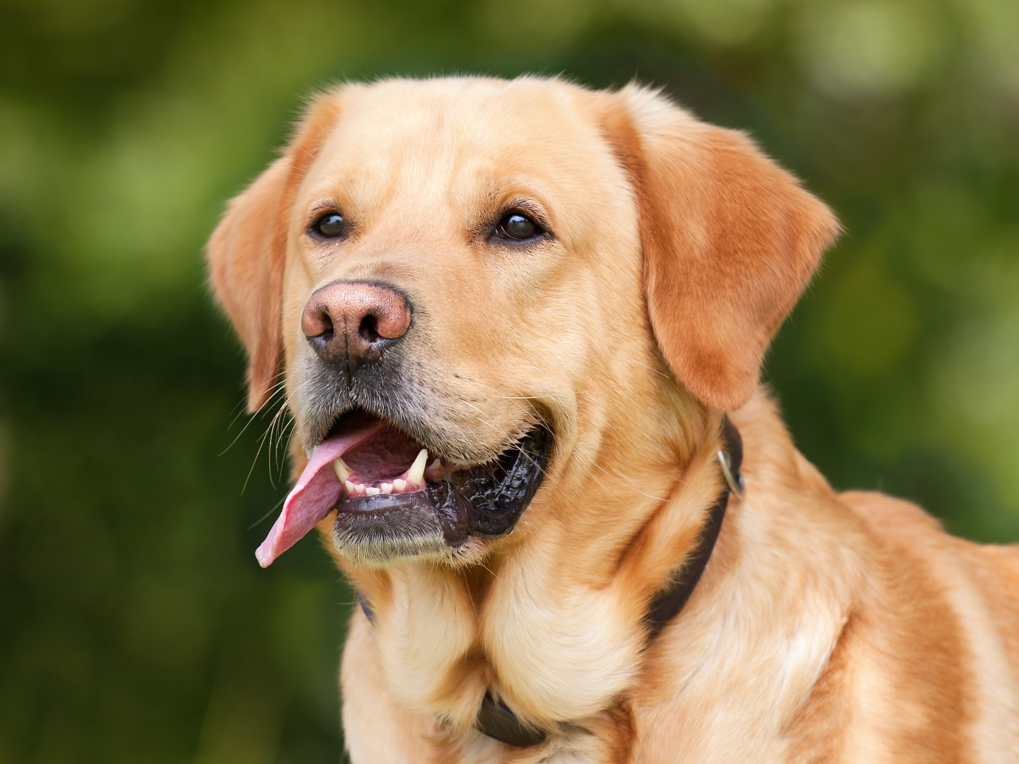
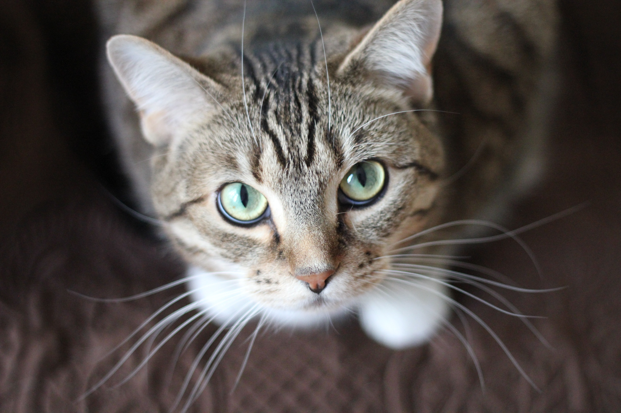
Dog
Supervised
Learning
Predictive
Model
Dog
Not Dog

Slide 3
Action
Observation
Agent
Environment
Reward

Slide 4
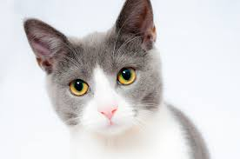
Set of Images
Set of content
imageContent = f(image)
Dog
Cat

